Slide 1
ICTW(A)-HTML
Name : Adarsh Suthar
Roll no : CE124
Assignment : 1
Lab no : 1
Aim : Understanding what is WWW, HTML, HTTP and URL; Basic structure of HTML Document; Creating an HTML Document; Understanding HTML Elements and Attributes; Headings; Paragraphs; Tags; Bold and Italic Texts; Whitespace in HTML; Horizontal and Vertical Line Breaks.

Slide 2
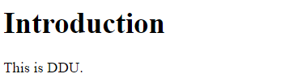
1.Introduction To Html
Code:
<!DOCTYPE html>
<html>
<head> Output :
<title>Page Title</title>
</head>
<body>
<h1>Introduction</h1>
<p>This is DDU.</p>
</body>
</html>

Slide 3
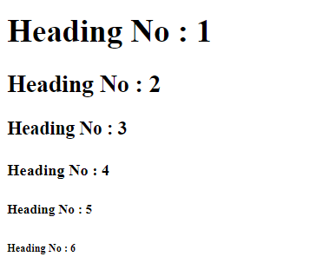
2.HTML Heading
Code:
<!DOCTYPE html>
<html>
<body>
Output :
<h1>Heading No : 1</h1>
<h2>Heading No : 2</h2>
<h3>Heading No : 3</h3>
<h4>Heading No : 4</h4>
<h5>Heading No : 5</h5>
<h6>Heading No : 6</h6>
</body>
</html>

Slide 4
4.HTML Paragraph
Code:
<!DOCTYPE html>
<html>
<body>
<p>
This paragraph
contains a lot of lines
in the source code,
but the browser
ignores it,we can write or display text as a paragraph via using 'p'.
</p>
</body>
</html> Output :

Slide 5
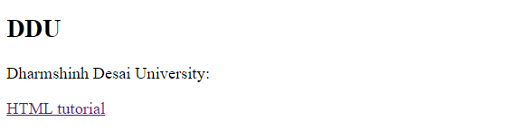
5.HTML Links
Code :
<!DOCTYPE html>
<html>
<body> Output :
<h2>DDU</h2>
<p>Dharmshinh Desai University:</p>
<p><a href="https://www.ddu.ac.in/">HTML tutorial</a></p>
</body>
</html>

Slide 6
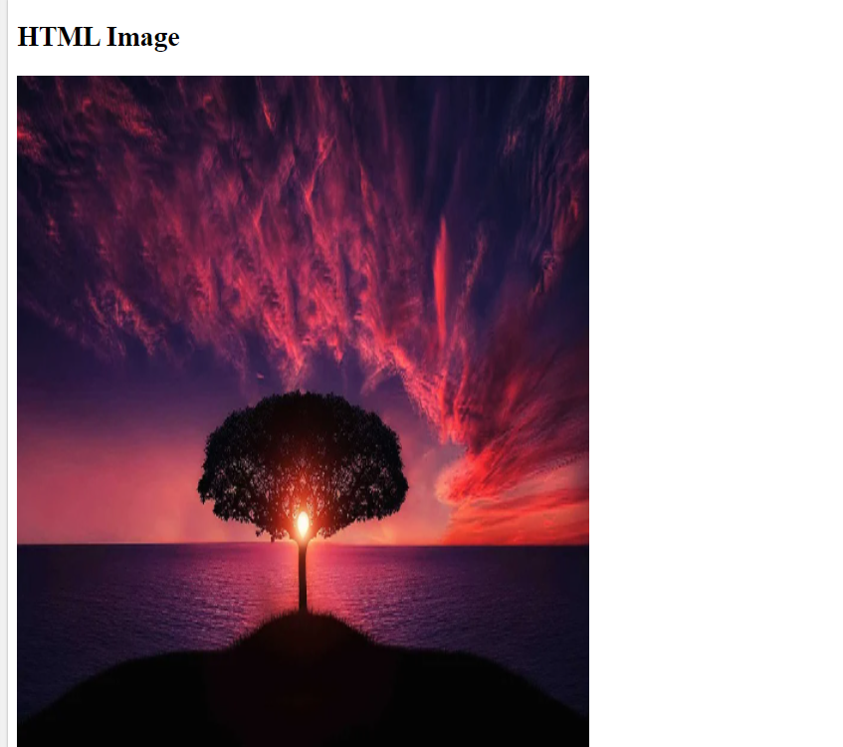
6.HTML Images
Code :
<!DOCTYPE html>
<html>
<body> Output :
<h2>HTML Image</h2>
<img src="https://cdn.pixabay.com/photo
/2015/04/23/22/00
/tree-736885_960_720.jpg"
alt="https://pixabay.com/" width="500"
height="600">
</body>
</html>

Slide 7
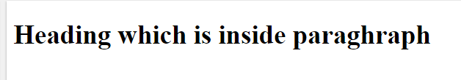
7.HTML Nested Elements
Code :
<!DOCTYPE html>
<html>
<body> Output :
<p><h1> Heading
which is inside paraghraph</h1></p>
</body>
</html>

Slide 8
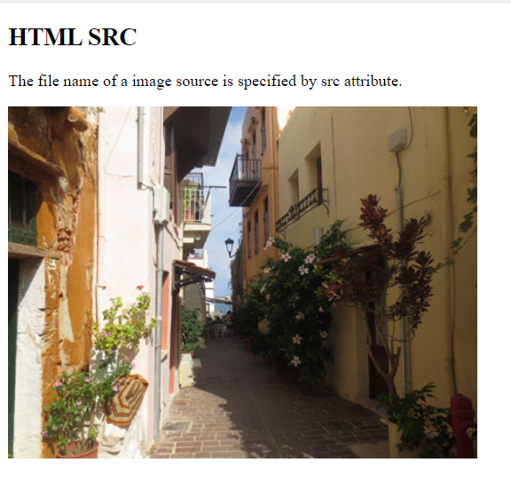
8.HTML SRC
Code :
<!DOCTYPE html>
<html>
<body> Output :
<h2>HTML SRC</h2>
<p>The
file name of a image source is specified by
src attribute.</p>
<img src="img_chania.jpg" alt="Flowers in Chania“
width="460" height="345">
</body>
</html>

Slide 9
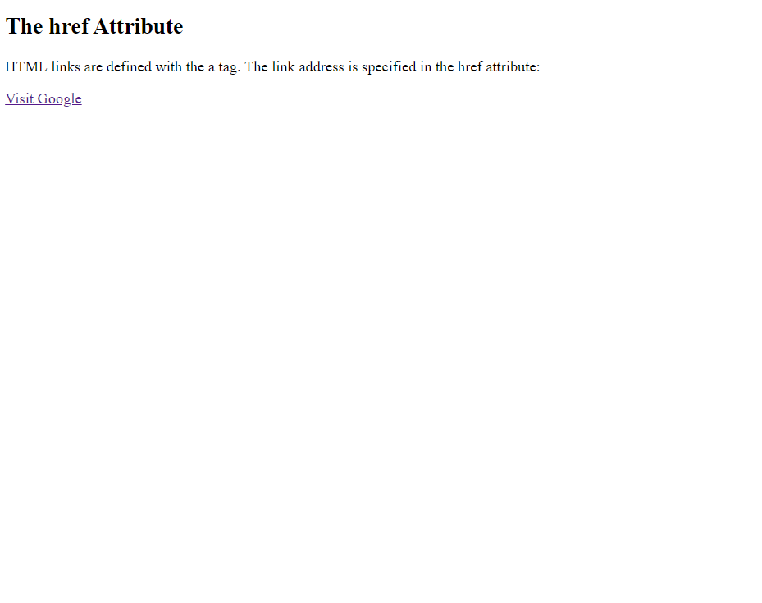
9.HTML HREF
Code :
<!DOCTYPE html>
<html>
<body>
Output :
<h2>The href Attribute</h2>
<p>HTML links are defined with the a tag.
The link address is specified in the
href attribute:</p>
<a href=https://www.google.co.in/
>Visit Google</a>
</body>
</html>

Slide 10
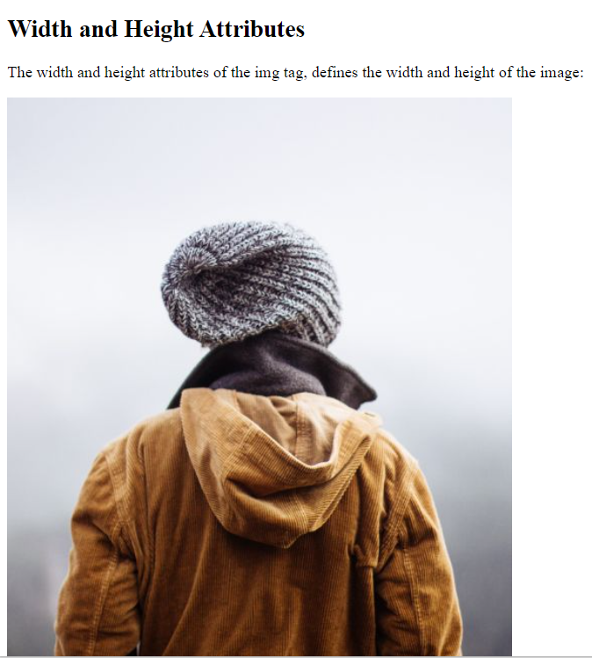
10.HTML hight and width
Code :
<!DOCTYPE html>
<html>
<body> Output :
<h2>Width and Height Attributes</h2>
<p>The width and height
attributes of the img tag, defines the
width and height of the image:</p>
<img src="img_girl.jpg" width="500"
height="600">
</body>
</html>

Slide 11
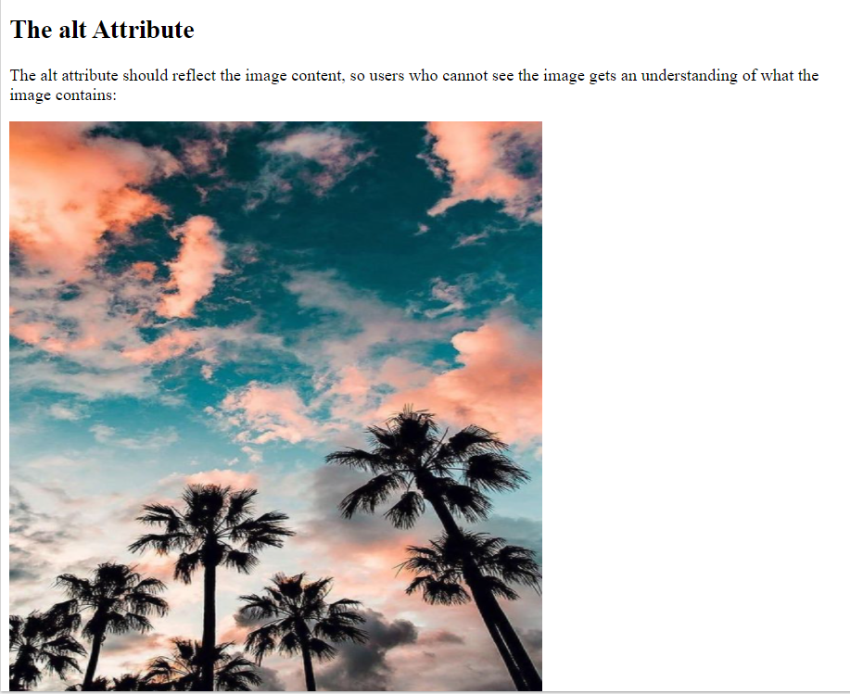
11.HTML ALT
Code :
<!DOCTYPE html>
<html>
<body>
<h2>The alt Attribute</h2> Output :
<p>The alt attribute should reflect the image content, s
o users who cannot see the image
gets an understanding of what the image contains:</p>
<img src="https://i.
pinimg.com/564x/1c/5f/a6/1c5fa62fd725dd
03d7a216f847a0c576.jpg" alt="https://in.pinterest.
com/pin/691161874043828738/"width="500" height="600">
</body>
</html>

Slide 12
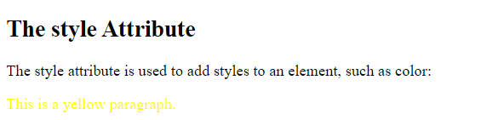
12.HTML STYLE
Code :
<!DOCTYPE html>
<html>
<body>
Output :
<h2>The style Attribute</h2>
<p>The style attribute is u
sed to add styles to an element, such
as color:</p>
<p style="color:yellow;">This is
a yellow paragraph.</p>
</body>
</html>

Slide 13
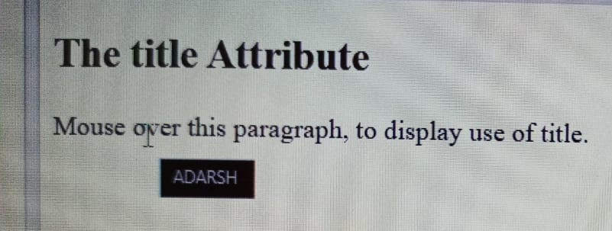
13.HTML TITLE
Code :
<!DOCTYPE html>
<html>
<body>
<h2 title="I'm a Output :
header">
The title Attribute</h2>
<p title="ADARSH">
Mouse over this
paragraph, to
display use of title.</p>
</body>
</html>

Slide 14
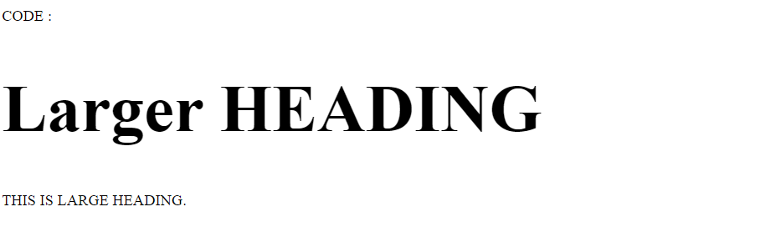
14.HTML Big Heading
Code :
CODE :
<!DOCTYPE html>
<html> Output :
<body>
<h1 style=“
font-size:90px;">
Larger HEADING</h1>
<p>THIS IS LARGE
HEADING.</p>
</body>
</html>

Slide 15
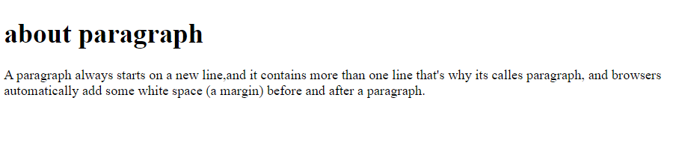
15. HTML PARAGRAPH
Code :
<!DOCTYPE html>
<html>
<body>
<h1>about paragraph</h1> Output :
<p>A
paragraph always starts on a
new line,and it contains mo
re than one line that's why
its calles
paragraph, and
browsers automatically add some w
hite space (a
margin) before and after a par
agraph.</p>
</body>
</html>

Slide 16
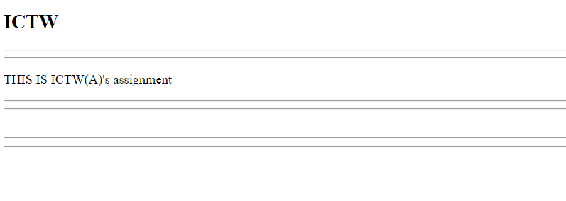
16. HTML HORIZNTAL RULESS
Code :
<!DOCTYPE html>
<html>
<body> Output :
<h2>ICTW</h2>
<hr>
<hr>
<p>THIS IS ICTW(A)'s assignment</p>
<hr>
<hr>
<br>
<hr>
<hr>
</body>
</html>

Slide 17
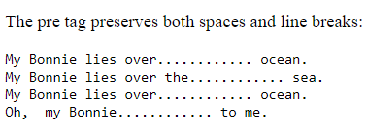
17.HTML PRE
Code :
<!DOCTYPE html>
<html>
<body> Output :
<p>The pre
tag preserves both spa
ces and line breaks:</p>
<pre>
My Bonnie lies over............ ocean.
My Bonnie lies over the............ sea.
My Bonnie lies over............ ocean.
Oh, my Bonnie............ to me.
</pre>
</body>
</html>

